Slide 1
Logics and Proofs
2021-22

Slide 2
Topic Outcomes
Explain the logic and inference rules.
Construct the proposition or predicate logic using the appropriate quantifiers for the given statements.
Apply the rules of inference and appropriate proof technique to infer the truth value.
Apply the appropriate proof technique to show that given statements are equivalent.

Slide 3
Contents
Introduction
Equivalence and Implication Equivalence of statements
Truth tables, De Morgan’s Laws, Implication
Variables and Quantifiers
Standard notation for quantification, Negation of quantified statements
Implicit quantification, Proof of quantified statements
Inference ,Direct Inference (Modus Ponens) and Proofs
Rules of inference for direct proofs
Contrapositive rule of inference, Proof by contradiction
Case Study

Slide 4
Introduction
Logic is the basis of all mathematical reasoning and all automated reasoning.
Logic is defined as the science of reasoning.
Practical applications of logic are,
Design of computing machines
Specification of systems
Artificial Intelligence
Computer Programming
Programming languages and so on.
The rules of logic give precise meaning to mathematical statements.

Slide 5
Introduction
There are many types of logic,
Syllogistic logic
Propositional logic
Predicate logic
Modal logic
Informal reasoning and dialectic
Mathematical logic
Philosophical logic
Computational logic
Non-classical logic

Slide 6
Propositions
Basic building blocks of logic.
Proposition is a declarative sentence that is either true or false, but not both.
Examples:
Hubli Dharwad are twin cities.
Bangalore is the capital of Maharashtra State.
Examples of non-declarative Sentences:
What a nice day!
What would you like to have for lunch?
Follow the instructions.
The area of logic that deals with propositions is called the propositional calculus or propositional logic. – First developed by Aristotle.

Slide 7
Notations
Propositions are represented by variables called proposition variables.
Examples:
p: Hubli Dharwad are twin cities
q: Bangalore is the capital of Maharashtra State.
The value of a proposition is called its truth value.
T or 1 if the value is true.
F or 0 if the value is false.
What will be the truth values for the above examples?

Slide 8

Activity
Identify which of the following statements are propositions. Also identify their truth value.
How are you?
C programming language is written by Dennis and Ritchie.
6+5=10
Answer this question.
x+2=5
What a wonderful place!
Set of natural numbers begin with zero.
There are two ISAs conducted for the students of KLE Tech.
Kindly do the following.
Logic is common sense.
T
F
F
T
T

Slide 9
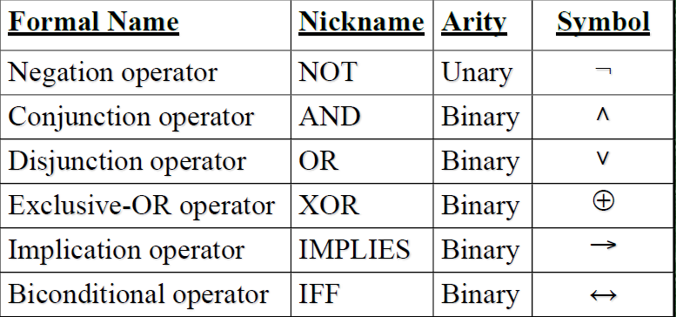
Logical Connectives
Logical operators used to combine two or more propositions are called as connectives. Such propositions are called compound propositions.

Slide 10
chunk2

Slide 11
Negation Operator
Let p be a proposition. The negation of p, denoted by ￢p (also denoted by p), is the statement “It is not the case that p.”
Examples:
p: Hubli Dharwad are twin cities.
¬p: It is not the case that Hubli Dharwad are twin cities.
q: Bangalore is the capital of Maharashtra State.
¬q: It is not the case that Bangalore is the capital of Maharashtra State.

Slide 12
Activity
Write the negation of the following propositions.
p: Heavy rainfall has created havoc in many places in India.
q: Shopkeeper does not have Rs. 100 change.
r: Yoga has the power to keep a human healthy.
s: Abby sent more than 100 text messages every day.
t: 7 · 11 · 13 = 999.
Notes:
¬p: It is not the case that heavy rainfall has created havoc in many places in India.

Slide 13
Truth Tables
What is a truth table?
A truth table shows how a proposition’s output responds to various combinations of the inputs.
Truth table for negation operator
If n are the number of propositions in the compound proposition then, number of rows in the truth table = 2^{n}
p | ¬p
T | F
F | T

Slide 14
Conjunction Operator
Let p and q be propositions. The conjunction of p and q, denoted by p ∧ q, is the proposition “p and q.”
The conjunction p ∧ q is true when both p and q are true and is false otherwise.
Example:
p: Hubli Dharwad are twin cities ,
q: Bangalore is the capital of Maharashtra State.
p ∧ q: Hubli Dharwad are twin cities and Bangalore is the capital of Maharashtra State.
Truth value?
p | q | p ∧ q
T | T | T
T | F | F
F | T | F
F | F | F
Remember: “∧” points up like an “A”, and it means “∧ND”

Slide 15
Disjunction Operator
Let p and q be propositions. The disjunction of p and q, denoted by p ∨ q, is the proposition “p or q.” It is also called inclusive or.
The disjunction p ∨ q is false when both p and q are false and is true otherwise.
Example:
p: Hubli Dharwad are twin cities ,
q: Bangalore is the capital of Maharashtra State.
p ∨ q: Hubli Dharwad are twin cities or Bangalore is the capital of Maharashtra State.
Truth value?
p | q | p ∨ q
T | T | T
T | F | T
F | T | T
F | F | F

Slide 16
Exclusive-OR Operator
Let p and q be propositions. The exclusive or of p and q, denoted by p ⊕ q, is the proposition that is true when exactly one of p and q is true and is false otherwise.
Example:
p: Supriya may pursue computer science engineering
q: Supriya may pursue civil engineering.
p ⊕ q: Supriya may either pursue computer science engineering or civil engineering.
Truth value?
p | q | p ⊕ q
T | T | F
T | F | T
F | T | T
F | F | F

Slide 17
Implication Operator
Let p and q be propositions. The conditional statement p → q is the proposition “if p, then q.”
The conditional statement p → q is false when p is true and q is false, and true otherwise.
Example:
p: Maria learns discrete mathematics
q: She will find a good job.
p → q: If Maria learns discrete mathematics, then she will find a good job.
Truth value?
Consequence/ conclusion
Hypothesis/ antecedent/ premise
p | q | p → q
T | T | T
T | F | F
F | T | T
F | F | T

Slide 18
Implication Operator
Conditional statement can also be expressed as any of the following,
“if p, then q” | “q when p”
“p implies q” | “q is necessary for p”
“if p, q” | “a necessary condition for p is q”
“p only if q” | “q follows from p”
“p is sufficient for q” | “q unless ￢p”
“a sufficient condition for q is p”
“q if p”
“q whenever p”

Slide 19
chunk3

Slide 20
Converse, Inverse and Contra positive
Conditional statement can be expressed in any of the form given below,
“if p, then q” | “q when p”
“p implies q” | “q is necessary for p”
“if p, q” | “a necessary condition for p is q”
“p only if q” | “q follows from p”
“p is sufficient for q” | “q unless ￢p”
“a sufficient condition for q is p”
“q if p”
Notes:
In this session we will study about
Converse, Inverse and Contra positive of
implication statement or Conditional statement .

Slide 21
Converse, Inverse and Contra positive
New conditional statements could be formed from the implication statement, p → q (if p, then q). They are,
Converse: q → p (if q, then p)
Inverse: ¬ p → ¬ q (if it is not the case that p, then it is not the case that q)
Contrapositive: ¬ q → ¬ p (if it is not the case that q, then it is not the case that p)
Conditional statement and its contra positive are equivalent They have same truth values.
Similarly, Converse and Inverse are equivalent.
.

Slide 22
Converse, Inverse and Contra positive
Example:
p: You can access the website, q: you pay a subscription fee.
p → q : If you can access the website then you paid a subscription fee.
Converse: q → p: If you pay the subscription fee then you can access the website
Inverse: ¬ p → ¬ q: If you cannot access the website then you have not paid the subscription fee.
Contra positive: ¬ q → ¬ p: If you have not paid the subscription fee then you cannot access the website.

Slide 23
Biconditional Operator
The biconditional statement p ↔ q is the
proposition “p if and only if q.” Biconditional
statements are also called bi-implications.
The biconditional statement p ↔ q is true
when p and q have the same truth values,
and is false otherwise.

Slide 24
Biconditional Operator
Example:
p: You can attend classes
q: You have to register for the course.
p ↔ q: You can attend classes if and only if
you register for the course.
Truth value?
p | q | p ↔ q
T | T | T
T | F | F
F | T | F
F | F | T

Slide 25
Biconditional Operator
Other common ways to express p ↔ q
are:
“p is necessary and sufficient for q”
“if p then q, and conversely”
“p iff q”
Find the correlation between the truth table of biconditional operator and exclusive or operator.
Note: The statement p ↔ q is true when both the conditional statements p → q and q → p are true and is false otherwise.

Slide 26
Precedence of Logical Operators
As in arithmetic, an ordering is imposed on the
use of logical operators in compound propositions
However, it is preferable to use parentheses to
disambiguate operators and facilitate readability
¬ p ∨ q ∧ ¬ r ≡ (¬p) ∨ (q ∧ (¬r))
To avoid unnecessary parenthesis, the following precedence hold:
Operator | Precedence
¬ | 1
∧ | 2
∨ | 3
→ | 4
↔ | 5

Slide 27
Activity
Let p and q be the propositions
p : I fell ill today.
q : I could not attend the classes.
Express each of these propositions as an English sentence.
a)￢p, b) p ∨ q, c) p → q, d) p ∧ q, e) p ↔ q, f )￢p →￢q,
g) ￢p ∧￢q, h) ￢p ∨ (p ∧ q), i) ￢q → p, j) p ↔￢q,
k) ￢p ∧ (p∨ ￢q)

Slide 28
Activity
Let p, q, r, s denote the following
statements
p: I finish writing my computer program before lunch
q: I shall play tennis in the afternoon
r: The sun is shining
s: The humidity is low
Write the following in symbolic form.
If the sun shining, I shall play tennis this afternoon.
Finishing the writing of my computer program before lunch is necessary for my playing tennis this afternoon.

Slide 29
Activity
For each of these sentences, determine
whether an inclusive or, or an exclusive
or, is intended.
Anuja likes Vanilla ice cream or Mango ice cream.
You can pay using U.S. dollars or Indian Rupees.
Construct the truth table for the
following.
p ∧￢p | (p ∧ q) → (p ∨ q) | p ⊕ (p ∨ q)
p ∨￢p | (p ↔ q) ∨ (￢p ↔ q)

Slide 30
chunk4

Slide 31
Equivalence
Compound propositions that have the same truth values in all possible cases are called logically equivalent.
Why do you need equivalent propositions?
To manipulate a set of statements (here, logical propositions) for the sake of mathematical argumentation, an important step is to replace one statement with another equivalent statement (i.e., with the same truth value)

Slide 32
Terminology
Tautology: A compound proposition that is always true, no matter what the truth values of the propositional variables that occur in it.
Example: p ∨￢p
Contradiction: A compound proposition that is always false.
Example: p ∧￢p
Contingency: A compound proposition that is neither a tautology nor a contradiction.
Example: p ∨ q → ¬r

Slide 33
Logical Equivalence
Definition: Propositions p and q are logically equivalent if p ↔ q is a tautology.
Informally, p and q are equivalent if whenever p is true, q is true, and vice versa.
Notation: p ≡ q (p is equivalent to q), p ↔ q, and p ⇔ q
Alert: ≡ is not a logical connective
How to find whether two compound propositions are logically equivalent?
Through Truth tables.
Through laws of equivalence.

Slide 34
Logical Equivalence: Truth table
Show that ￢(p ∨ q) and ￢p ∧￢q are logically equivalent.
p | q | p ∨ q | ￢(p ∨ q) | ￢p | ￢q | ￢p ∧￢q
T | T | T | F | F | F | F
T | F | T | F | F | T | F
F | T | T | F | T | F | F
F | F | F | T | T | T | T
The two columns in the truth table are identical, thus we conclude that
￢(p ∨ q) ≡ ￢p ∧￢q
De Morgan’s Law

Slide 35
Activity
Show that the LHS and RHS in the following are logically equivalent using truth table.
(p ∨ q) ∨ r ≡ p ∨ (q ∨ r)
￢(p ∧ q) ≡ ￢p ∨￢q
p ∨ (p ∧ q) ≡ p
p → q ≡ ￢p ∨ q
p → q ≡ ￢q →￢p
p ↔ q ≡ (p → q) ∧ (q → p)
p ↔ q ≡ (p ∧ q) ∨ (￢p ∧￢q)
p⊕q ⇔ (p∨q)∧¬(p∧q)

Slide 36
Logical Equivalence: Laws of Logic
Names | Equivalences
Identity Law | p∧T ⇔ p
 | p∨F ⇔ p
Domination Law | p∨T ⇔ T
 | p∧F ⇔ F
Idempotent Law | p∨p ⇔ p
 | p∧p ⇔ p
Double negation Law | ¬¬p ⇔ p
Commutative Law | p∨q ⇔ q∨p
 | p∧q ⇔ q∧p

Slide 37
Logical Equivalence: Laws of Logic
Names | Equivalences
Associative Law | (p∨q)∨r ⇔ p∨(q∨r)
 | (p∧q)∧r ⇔ p∧(q∧r)
Distributive Law | p∨(q∧r) ⇔ (p∨q)∧(p∨r)
 | p∧(q∨r) ⇔ (p∧q)∨(p∧r)
De Morgan’s Law | ¬(p∧q) ⇔ ¬p ∨ ¬q
 | ¬(p∨q) ⇔ ¬p ∧ ¬q
Absorption Law | p ∨ (p ∧ q) ⇔ p
 | p ∧ (p ∨ q) ⇔ p
Negation Law | p ∧ ¬p ⇔ F

Slide 38
Example
Show that ￢(p → q) and p ∧￢q are logically equivalent.
Solution:
￢(p → q) ≡ ￢(￢p ∨ q) [as p → q ≡ ￢p ∨ q]
≡ ￢(￢p)∧￢q [second De Morgan law]
≡ p ∧￢q [double negation law]

Slide 39
Example
Show that p ↔ q and (p ∧ q) ∨ (￢p ∧￢q) are logically equivalent.
Solution:
p ↔ q ≡ (p→q) ∧ (q→p)
≡ (￢p ∨ q) ∧ (q→p) [as p → q ≡ ￢p ∨ q]
≡ (￢p ∨ q) ∧ (￢q ∨ p) [as q → p ≡ ￢q ∨ p]
≡ ((￢p ∨ q) ∧ ￢q)∨ ((￢p ∨ q) ∧ p)
[Distributive law]
≡ ((￢p ∧￢q) ∨ (q ∧ ￢q)) ∨ ((￢p ∨ q) ∧ p)
[Distributive law]

Slide 40
Example Cont…
p ↔ q ≡ ((￢p ∧￢q) ∨ (q ∧ ￢q)) ∨ ((￢p ∧ p) ∨ (p ∧ q))
[Distributive law]
≡((￢p ∧￢q) ∨ F) ∨ ((￢p ∧ p) ∨ (p ∧ q))
[Negation law]
≡((￢p ∧￢q) ∨ F) ∨ (F ∨ (p ∧ q)) [Negation law]
≡(￢p ∧￢q) ∨ (F ∨ (p ∧ q)) [Identity law]
≡(￢p ∧￢q) ∨ (p ∧ q) [Identity law]
p ↔ q ≡ (p ∧ q) ∨ (￢p ∧￢q) [Commutative law]

Slide 41
chunk5

Slide 42
Activity
Show that the LHS and RHS in the following are logically equivalent using laws of equivalence.
(¬p∨q)∧(p ∧ (p ∧ q))≡ p∧ q
Determine whether (￢p ∧ (p → q))→￢q is a tautology using both truth table and laws of logical equivalence.
Show that (p → q) → r and p → (q → r) are not logically equivalent.

Slide 43
chunk6

Slide 44
Predicates and Quantifiers
Propositional logic cannot adequately express the meaning of all statements in mathematics and in natural language.
Example: What is the truth value of the following statement?
“Every computer connected to the university network is functioning properly.”
Why do we need predicate logic?
To express the meaning of a wide range of statements in mathematics and computer science in ways that permit us to reason and explore relationships between objects.
What is predicate logic?
Predicate logic is an extension of propositional logic that permits concisely reasoning about whole classes of entities.

Slide 45
Practical Applications
It is the basis for clearly expressed formal specifications for any complex system.
It is basis for automatic theorem provers and many other Artificial Intelligence systems.
E.g: automatic program verification systems.
Predicate-logic like statements are supported by some of the more sophisticated database query engines and container class libraries
these are types of programming tools.

Slide 46
Predicates
In the following sentence,
“computer x is under attack by an intruder”
The phrase “computer x” denotes the subject the object or entity that the sentence is about.
The phrase “is under attack by an intruder” denotes the predicate – a property that is true of the subject.
In predicate logic, a predicate is modeled as a function P(.) from objects to propositions.
P(x)= x is under attack by an intruder

Slide 47
Predicates
Convention: Lowercase variables x, y, z... denote objects/entities; uppercase variables P, Q, R… denote propositional functions (predicates).
Keep in mind that the result of applying a predicate P to an object x is the proposition P(x).
But the predicate P itself (e.g. P=“is under attack by an intruder”) is not a proposition (not a complete sentence).
E.g. if P(x) = “x is a prime number”,
P(3) is the proposition “3 is a prime number.”

Slide 48
Predicates
Statements could also involve more than one object.
Eg. : “x+y ≥ x”
Q(x,y) where Q is predicate and x and y are the objects.
What is the truth value of Q(1,3) and Q(2,0) where Q(x,y): x+y ≥ x?
We can then say, “For any whole numbers x,y, Q(x,y) is true” instead of showing it for each value of x and y.
The collection of values that a variable x can take is called x’s universe of discourse or domain.

Slide 49
chunk7

Slide 50
Quantifiers
Quantifiers provide a notation that allows us to quantify (count) how many objects in the universe of discourse satisfy a given predicate.
The area of logic that deals with predicates and quantifiers is called the predicate calculus.
Types of Quantification:
Universal Quantifier
Existential Quantifier

Slide 51
Universal Quantification
Definition: The universal quantification of P(x) is the statement
“P(x) for all values of x in the domain.”
The notation ∀xP(x) denotes the universal quantification of P(x). Here ∀ is called the universal quantifier.
We read ∀xP(x) as “for all xP(x)” or “for every xP(x).”
An element for which P(x) is false is called a counterexample of ∀xP(x).
Note: The domain must always be specified when a universal quantifier is used.

Slide 52
Universal Quantification
Example:
Let the domain of x be parking spaces at UF.
Let P(x) be the predicate “x is full.”
Then the universal quantification of P(x),
∀x P(x), is the proposition:
“All parking spaces at UF are full.”
i.e., “Every parking space at UF is full.”
i.e., “For each parking space at UF, that space is full.”

Slide 53
Existential Quantification
Definition: The existential quantification of P(x) is the proposition “There exists an element x in the domain such that P(x).”
We use the notation ∃xP(x) for the existential quantification of P(x). Here ∃ is called the existential quantifier.
Note: A domain must always be specified when a statement ∃xP(x) is used.
Other ways to express ∃xP(x) are, “for some,” “for at least one,” or “there is.”

Slide 54
Existential Quantification
Example:
Let the u.d. of x be parking spaces at UF.
Let P(x) be the predicate “x is full.”
Then the existential quantification of P(x), ∃x P(x), is the proposition:
“Some parking space at UF is full.”
“There is a parking space at UF that is full.”
“At least one parking space at UF is full.”

Slide 55
Precedence of Quantifiers
The quantifiers ∀ and ∃ have higher precedence than all logical operators from propositional calculus.
Example: ∀xP(x) ∧ Q(x) means (∀xP(x) ) ∧ Q(x)
Operator | Precedence
∀, ∃ | 1
¬ | 2
∧ | 3
∨ | 4
→ | 5
↔ | 6

Slide 56
Free and Binding Variables
An expression like P(x) is said to have a free variable x (meaning, x is undefined).
A quantifier (either ∀ or ∃) operates on an expression having one or more free variables, and binds one or more of those variables, to produce an expression having one or more bound variables.
Example: ∃x(x + y = 1)
the variable x is bound by the existential quantification ∃x, but the variable y is free because it is not bound by a quantifier and no value is assigned to this variable.
What about here? ∃x(P(x) ∧ Q(x)) ∨ ∀xR(x)

Slide 57
chunk8

Slide 58
Logical Equivalence involving Quantifiers
Statements involving predicates and quantifiers are logically equivalent if and only if they have the same truth value no matter which predicates are substituted into these statements and which domain of discourse is used for the variables in these propositional functions.
The notation S ≡ T is used to indicate that two statements S and T involving predicates and quantifiers are logically equivalent.

Slide 59
Example
Show that ∀x (P(x) ∧Q(x)) and ∀ x P(x) ∧ ∀ x Q(x) are logically equivalent.
Solution:
Part1: Show if ∀x (P(x) ∧Q(x)) is true then ∀ x P(x) ∧ ∀ x Q(x) is true. (using direct technique)
Assume ∀x (P(x) ∧Q(x)) is true.
If a is in the domain, then P(a) ∧ Q(a) is true.
So, P(a) is true and Q(a) is true.
Since P(a) and Q(a) are both true for every element in the domain, ∀x P(x) and ∀x Q(x) are both true.
So, ∀ x P(x) ∧ ∀ x Q(x) is true.

Slide 60
Example
Part2: Show if ∀ x P(x) ∧∀ x Q(x) is true then ∀x (P(x) ∧ Q(x)) is true. (using direct technique)
Assume ∀x P(x) ∧ ∀x Q(x) is true.
So, ∀x P(x) is true and ∀x Q(x) is true.
If a is in the domain, then P(a) is true and Q(a) is true.
If P(a) is true and Q(a) is true, then P(a) ∧ Q(a) is true.
Since P(a) ∧ Q(a) is true for every element in the domain,
∀ x (P(x) ∧ Q(x)) is true.
So, ∀ x (P(x) ∧ Q(x)) ≡ ∀ x P(x) ∧ ∀ x Q(x).

Slide 61
Activity
Determine whether ∀x (P(x) ∨ Q(x)) and ∀x P(x) ∨ ∀x Q(x) are logically equivalent.
Solution:
Give an example that ∀ x (P(x) ∨ Q(x)) and ∀ x P(x) ∨ ∀ x Q(x) have different truth values.
P(x): x is odd. Q(x): x is even. (in the domain of integers.)
For all element (P(x) ∨ Q(x)) is true. (all x is odd or even.)
So, ∀x (P(x) ∨ Q(x)) is true.
For all element P(x) is false. (all x is not odd.)
For all element Q(x) is false. (all x is not even.)
So, ∀x P(x) ∨ ∀x Q(x) is false.
Thus, ∀x (P(x) ∨ Q(x)) and ∀x P(x) ∨ ∀x Q(x) are not logically equivalent.

Slide 62
chunk9

Slide 63
Negation of Quantified Expressions
Consider the following example,
Every student in your class are attending the seminar.
The above statement can be represented as ∀x P(x) where P(x) is x is attending the seminar and domain is the class of students.
What will be the negation of the above example, ¬ ∀x P(x)?
It is not the case that every student in your class are attending the seminar.
i.e. There is a student in your class who is not attending the seminar.
Now consider P(x) stated above for the same domain and write the expression. It will be ∃x ¬ P(x).

Slide 64
Negation of Quantified Expressions
Consider the following example,
There is a student in your class who tops all exams.
The above statement can be represented as ∃ x Q(x) where Q(x) is x tops all exams and domain is the class of students.
What will be the negation of the above example, ¬ ∃ x Q(x)?
It is not the case that there is a student in your class who tops all exams.
i.e. Every student in your class do not top all exams.
Now consider Q(x) stated above for the same domain and write the expression. It will be ∀x ¬ Q(x).

Slide 65
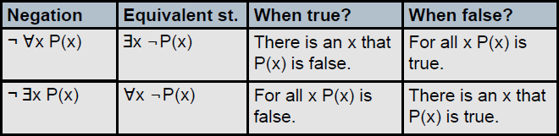
Negation of Quantified Expressions
The following equivalence applies irrespective of the domain and predicate.
¬ ∀xP(x) ≡ ∃x ¬ P(x).
∃xQ(x) ≡ ∀x ¬ Q(x).
The rules for negations for quantifiers are called De Morgan’s laws for quantifiers.

Slide 66
Translating from English into Logical Expressions
Translating sentences in English (or other natural languages) into logical expressions is a crucial task in mathematics, logic programming, artificial intelligence, software engineering, and many other disciplines.
Example: Express the statement “Every student in this class has studied calculus” using predicates and quantifiers.
Rewrite it as “For every student x in this class, x has studied calculus.”
Introduce C(x), which is the statement “x has studied calculus.”
If the domain considered is class of students then the expression will be ∀xC(x)

Slide 67
Translating from English into Logical Expressions
For the previous example if the domain considered is all people then the statement will have to be rewritten as,
“For every person x, if person x is a student in this class then x has studied calculus.”
If S(x) represents the statement that person x is in this class and C(x) is “x has studied calculus.”, the statement above can be expressed as ∀x(S(x) → C(x)).

Slide 68
Using Quantifiers in System Specifications
Use predicates and quantifiers to express the system specifications “Every mail message larger than one megabyte will be compressed”
Solution:
Let S(m, y) be “Mail message m is larger than y megabytes,” where the variable x has the domain of all mail messages and the variable y is a positive real number
Let C(m) denote “Mail message m will be compressed.”
Then the specification can be represented as
∀m(S(m, 1) → C(m)).

Slide 69
Using Quantifiers in System Specifications
Use predicates and quantifiers to express the system specifications “If a user is active, at least one network link will be available.”
Solution:
Let A(u) represent “User u is active,” where the variable u has the domain of all users
Let S(n, x) denote “Network link n is in state x,” where n has the domain of all network links and x has the domain of all possible states for a network link.
Then the specification can be represented by
∃uA(u) → ∃nS(n, available)

Slide 70
Activity
Translate these statements into English, where C(x) is “x is an actor” and F(x) is “x is very popular” and the domain consists of all people.
∀xC(x), ￢∃xF(x), ∃x￢F(x),￢∀xC(x)
∀x(C(x) → F(x)), ∀x(C(x) ∧ F(x)), ∃x(C(x) → F(x)), ∃x(C(x) ∧ F(x))

Slide 71
Activity
2. Let C(x) be the statement “x has a cat,” let D(x) be the statement “x has a dog,” and let F(x) be the statement “x has a ferret.” Express each of these statements in terms of C(x), D(x), F(x), quantifiers, and logical connectives. Let the domain consist of all students in your class.
All students in your class have a cat, a dog, or a ferret.
Some student in your class has a cat and a ferret, but not a dog.
3. For each of these statements find a domain for which the statement is true and a domain for which the statement is false.
Everyone speaks Hindi.
There is someone older than 21 years.

Slide 72
Activity
4. Express each of these statements using quantifiers. Then form the negation of the statement so that no negation is to the left of a quantifier. Next, express the negation in simple English.
All dogs have fleas.
There is a horse that can add.
No monkey can speak French.
5. Show that ∃x(P(x) ∨ Q(x)) and ∃xP(x) ∨ ∃xQ(x) are logically equivalent.

Slide 73
Nested Quantifiers
Nested quantifiers: Expressions where one quantifier is within the scope of another.
Note that everything within the scope of a quantifier can be thought of as a propositional function.
Example: ∃ x ∀y(x*y = 0)
The above example can be represented as follows,
∃x Q(x) where Q(x) is ∀yP(x,y).
Where P(x,y) is x*y = 0

Slide 74
Example
If R(x,y)=“x relies upon y,” express the following in unambiguous English.
∀x(∃y R(x,y))=
∃y(∀x R(x,y))=
∃x(∀y R(x,y))=
∀y(∃x R(x,y))=
∀x(∀y R(x,y))=
Everyone has someone to rely on.
There’s someone on whom everyone relies upon (including himself)!
There’s some person who relies upon everybody (including himself).
Everyone has someone who relies upon them.
Everyone relies upon everybody, (including themselves)!
Notes:
We can explain every example here using the loops concept.

Slide 75
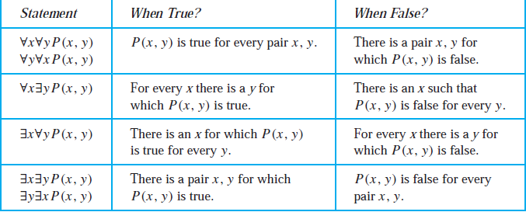
Order of Quantifiers
From the previous examples it is clear that the meaning of the statements change with the change in the order of the quantifier.

Slide 76
Example
Let Q(x, y) denote “x * y = 1.” What are the truth values of the quantifications ∃y∀xQ(x, y) and ∀x∃yQ(x, y), where the domain for all variables consists of all real numbers?
Solution: The quantification ∃y∀xQ(x, y) denotes the proposition “There is a real number y such that for every real number x, Q(x, y).”
For this statement to be true, there must be a particular value of y for which P(x, y) is true regardless of the choice of x i.e. y is constant.
So the statement is false.

Slide 77
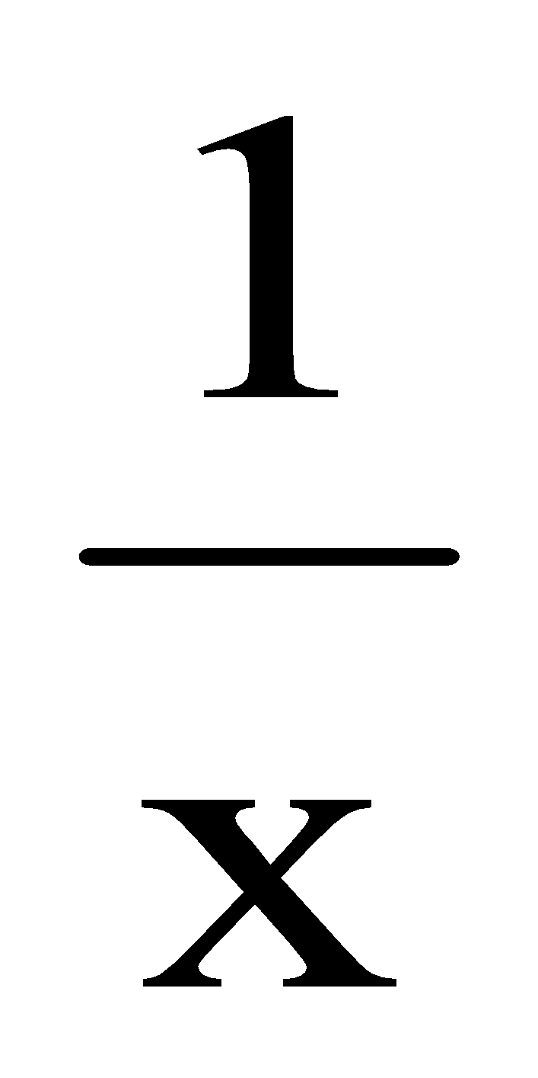
Example
The quantification ∀x∃yQ(x, y) denotes the proposition “For every real number x there is a real number y such that Q(x, y).”
For this statement to be true, no matter which x is chosen, there must be a value of y (possibly depending on the x you choose) for which P(x, y) is true.
There is such value of y where the above statement can be true which is y=
Hence the above statement is true.

Slide 78
Translation of Mathematical Statements
Translate the statement “The sum of two odd integers is always even” into a logical expression.
Solution:
Step 1: Rewrite
Step 2: Rewrite the rewritten
Step 3: Write the expression using quantifiers.

Slide 79
Translation of Mathematical Statements
Translate the statement “The sum of two positive integers is always positive” into a logical expression.
Solution:
Step 1 (Rewrite): “For every two integers, if these integers are both positive, then the sum of these integers is positive.”
Step 2 (Rewrite the rewritten): “For all positive integers x and y, x + y is positive.”
Step 3 (Write the expression using the quantifiers):
∀x∀y((x > 0) ∧ (y > 0) → (x +y > 0))

Slide 80
Translation into English
Translate the statement ∀x(C(x) ∨ ∃y(C(y) ∧ F(x, y))) into English, where C(x) is “x has a 32GB pen drive,” F(x, y) is “x and y are friends,” and the domain for both x and y consists of all students in your school.
Solution:
For every student x in your school, x has a 32GB pendrive or there is a student y such that y has a 32GB pendrive and x and y are friends.
In other words, every student in your school has a 32GB pendrive or has a friend who has a 32GB pendrive.

Slide 81
Translating English Statements to logical Expressions
Express the statement “If a person is female and is a parent, then this person is someone’s mother” as a logical expression involving predicates, quantifiers with a domain consisting of all people, and logical connectives.
Solution:
Rewrite: “For every person x, if person x is female and person x is a parent, then there exists a person y such that person x is the mother of person y.”
Predicates: F(x):“x is female,” P(x):“x is a parent,” and M(x, y):“x is the mother of y.”
Expression: ∀x((F (x) ∧ P(x)) → ∃yM(x, y))
i.e. ∀x∃y((F (x) ∧ P(x)) → M(x, y))

Slide 82
Negation of Nested Quantifiers
Express the negation of the statement ∀x∃y(x+y = 1) so that no negation precedes a quantifier.
Solution: Applying De Morgan’s law of Quantifiers,
¬ ∀x∃y(x+y = 1) ≡ ∃x ¬ ∃y(x+y = 1)
≡ ∃x ∀y ¬(x+y = 1)
≡ ∃x ∀y (x+y ≠ 1)

Slide 83
Activity
1. Translate these statements into English, where the domain for each variable consists of all real numbers.
∀x∃y(x < y)
∀x∀y(((x ≥ 0) ∧ (y ≥ 0)) → (xy ≥ 0))
∀x∀y∃z(xy = z)
2. Let W(x, y) mean that student x has visited website y, where the domain for x consists of all students in your school and the domain for y consists of all websites. Express each of these statements by a simple English sentence.
∃yW(José Orez, y)
∃xW(x, www.imdb.org)

Slide 84
Activity
3. Let Q(x, y) be the statement “student x has been a contestant on quiz show y.” Express each of these sentences in terms of Q(x, y), quantifiers, and logical connectives, where the domain for x consists of all students at your school and for y consists of all quiz shows on television.
There is a student at your school who has been a contestant on a television quiz show.
No student at your school has ever been a contestant on a television quiz show.

Slide 85
Activity
4. Express each of these mathematical statements using predicates, quantifiers, logical connectives, and mathematical operators.
The product of two negative real numbers is positive.
The difference of a real number and itself is zero.
5. Express the negations of each of these statements so that all negation symbols immediately precede predicates.
∃z∀y∀xT (x, y, z)
∃x∃yP(x, y) ∧ ∀x∀yQ(x, y)
∃x∃y(Q(x, y) ↔ Q(y, x))
∀y∃x∃z(T (x, y, z) ∨ Q(x, y))

Slide 86
Logics and Proofs
2022-23

Slide 87
Topic Outcomes
Explain the logic and inference rules.
Construct the proposition or predicate logic using the appropriate quantifiers for the given statements.
Apply the rules of inference and appropriate proof technique to infer the truth value.
Apply the appropriate proof technique to show that given statements are equivalent.

Slide 88
Contents
Inference rules
Direct Inference (Modus Ponens) and Proofs
Rules of inference for direct proofs
Contrapositive rule of inference
Proof by contradiction

Slide 89
Story
Assume that you are the famous detective in your classroom.
Some one in your classroom has robbed 32GB pendrive of your classmate.
Now it is your task to find the robber.
Through your investigation you come to know that your classmate who lost the pendrive saw it last when she was leaving the classroom and was the last person to leave the class but was interrupted by her friend from another division.
Your classmate says that she was using her pendrive just before she left and had inserted it to her laptop.

Slide 90
Story
If her friend actually interrupted your classmate before leaving then there are possibilities that your classmate gave the pendrive to her friend and forgot about it.
You came to know that your classmate is speaking the truth.
What do you think happened?
How did you arrive at such conclusion?
What proofs do you have to support your conclusion?
Notes:
Conclude the story saying that they deduced the conclusion from previous arguments and they have proofs through logic.

Slide 91
Proofs in mathematics are valid arguments
An argument is a sequence of statements that end in a conclusion
Valid means that the conclusion must follow from the truth of the preceding
statements or premises
We use rules of inference to construct valid arguments

Slide 92
Valid Arguments in Propositional Logic
Is this a valid argument?
If you listen you will hear what I’m saying
You are listening
Therefore, you hear what I am saying
Let p represent the statement “you listen”
Let q represent the statement “you hear what I am saying”
The argument has the form:

Slide 93
Valid Arguments in Propositional Logic
is a tautology (always true)
This is another way of saying that

Slide 94
Valid Arguments in Propositional Logic
When we replace statements/propositions with propositional variables
we have an argument form.
Definition:
An argument (in propositional logic) is a sequence of propositions.
All but the final proposition are called premises.
The last proposition is the conclusion.
The argument is valid iff the truth of all premises implies the conclusion is true
An argument form is a sequence of compound propositions involving propositional variables.

Slide 95
Valid Arguments in Propositional Logic
The argument form with premises
and conclusion
is valid when
is a tautology
We prove that an argument form is valid by using the laws of inference
But we could use a truth table. Why not?

Slide 96
The 1st law
Rules of Inference for Propositional Logic
modus ponens
aka
law of detachment
modus ponens (Latin) translates to “mode that affirms”

Slide 97
Rules of Inference for Propositional Logic
modus ponens
If it’s a nice day then, we’ll go to the beach. Assume the hypothesis
“it’s a nice day” is true. Then by modus ponens it follows that
“we’ll go to the beach”.

Slide 98
Rules of Inference for Propositional Logic
modus ponens
A valid argument can lead to an incorrect conclusion
if one of its premises is wrong/false!

Slide 99
modus ponens
A valid argument can lead to an incorrect conclusion if one of its premises is wrong/false!
The argument is valid as it is constructed using modus ponens.
But one of the premises is false (p is false).
So, we cannot derive the conclusion.

Slide 100
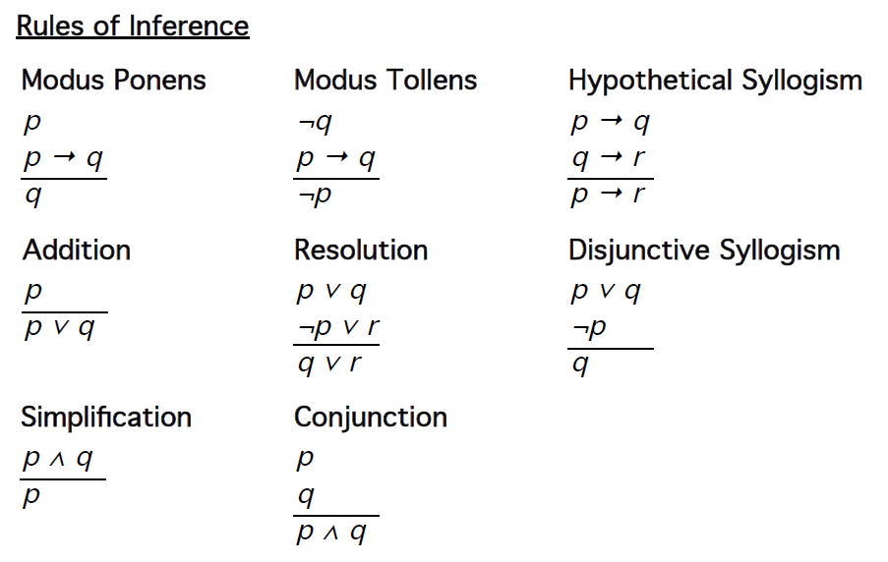

Slide 101
You might think of this as some sort of game.
You are given some statement, and you want to see if it is a valid argument and true
You translate the statement into argument form using propositional variables, and make sure you have the premises right, and clear what is the conclusion
You then want to get from premises/hypotheses (A) to the conclusion (B) using the rules of inference.
So, get from A to B using as “moves” the rules of inference

Slide 102
An example
Using the Rules of Inference to Build Arguments
It is not sunny this afternoon and it is colder than yesterday.
If we go to play tennis, it is sunny.
If we do not go to play tennis then we will go to see the exhibition.
If we go to see the exhibition then we will be home by sunset.
We will be home by sunset.

Slide 103
An example
Using the Rules of Inference to Build Arguments
It is not sunny this afternoon and it is colder than yesterday.
If we go to play tennis, it is sunny.
If we do not go to play tennis then we will go to see the exhibition.
If we go to see the exhibition then we will be home by sunset.
We will be home by sunset.
propositions
hypotheses

Slide 104
An example

Slide 105
Ambreesh is cycling or it is not raining.
It is raining or Bharat is playing cricket.
Consequently Ambreesh is cycling or Bharat is playing cricket.
We want to show that (3) follows from (1) and (2)

Slide 106
Ambreesh is cycling or it is not raining.
It is raining or Bharat is playing cricket.
Consequently Ambreesh is cycling or Bharat is playing cricket.
hypotheses
propositions
Resolution rule
Consequently Ambreesh is cycling or Bharat is playing cricket.

Slide 107
Activity
Use rules of inference to show that the hypotheses “Ram works hard,” “If Ram works hard, then he is a dull boy,” and “If Ram is a dull boy, then he will not get the job” imply the conclusion “Ram will not get the job.”
Write the following arguments in symbolic form and establish its validity using rules of inference. If Rochelle gets the supervisor’s position and works hard, then she’ll get a raise. If she does not get the raise then she’ll not buy a new car. She has purchased a new car. Therefore, she worked hard and got the supervisor’s position.
3. p → q
¬p → r
r → s

Slide 108
Activity
Use rules of inference to show that the hypotheses implies conclusion in the following. If the band did not play rock music or the refreshments were not delivered on time, then the party would have been cancelled and Ananya would have been angry. If the party were cancelled, then refunds would have had to be made. No refunds were made. Therefore, the band could play rock music.
Establish the validity of the following,

Slide 109
Rules of Inference & Quantified Statements
All men are £$%^$*(%, said Jane
John is a man
Therefore John is a £$%^$*(
Above is an example of a rule called “Universal Instantiation”.
We conclude P(c) is true, where c is a particular/named element
in the domain of discourse, given the premise

Slide 110
Rules of Inference & Quantified Statements

Slide 111
All men are £$%^$*(%, said Jane
John is a man
Therefore John is a £$%^$*(
premises
premises

Slide 112
Activity
For the collections of premises, what relevant conclusion or conclusions can be drawn? Explain the rules of inference used to obtain the conclusion from the premises.
“All rodents gnaw their food.” “Mice are rodents.” “Rabbits do not gnaw their food.” “Bats are not rodents.”
“Every computer science major has a personal computer.” “Ralph does not have a personal computer.” “Ann has a personal computer.”
“In triangle XYZ there is no pair of angles of equal measure.” “ If a triangle has two sides of equal length, then it is isosceles.” “ If a triangle is isosceles, then it has two angles of equal measure.” Consider P(t) as t has two sides of equal length, Q(t) as t is an isosceles triangle and R(t) as t has two angles of equal measure.

Slide 113
Activity
2. For the universe of all real numbers, establish the validity of following statements using rules of inference.
If 3x-7=20, then 3x=27.
If 3x=27, then x=9.
Therefore, if 3x-7=20, then x=9
3. Establish the validity of the following statements using rules of inference.

Slide 114
Terminologies
Theorem: A theorem is a statement that can be shown to be true (via a proof).
Proof: A proof is a sequence of statements that form a valid argument that establishes the truth of the theorem.
Axioms: Axioms or postulates are statements taken to be self evident or assumed to be true
Lemma: A lemma (plural lemmas or lemmata) is a less important theorem useful within the proof of other theorems.
Corollary: A corollary is a theorem that can be established directly from theorem that has just been proved.
Proposition: A proposition is usually a ‘less’ important theorem

Slide 115
Terminologies
Conjecture: A conjecture is a statement that is being proposed to be a true statement, usually on the basis of some partial evidence, a heuristic argument, or the intuition of an expert.
Note: The rules of inference are the means used to draw conclusions from other assertions, and to derive an argument or a proof

Slide 116
Methods of proofs
Different methods of proofs show that the conditional statement is true.
Direct proofs
Indirect proofs
Vacuous proofs
Trivial proofs
Proof by contradiction
Proof by cases
Proofs of equivalence
Existence proofs
Uniqueness proofs
Counterexamples
To prove p→q is true, it should be shown that q is true only if p is true.

Slide 117
Direct Proof
Straight forward approach of proof based on Modus Ponens inference rule.
For p→q, assume p is true and prove q is also true using, axioms, definitions, previously proven theorems and rules of inference.
Example: Prove that the sum of two odd integers is even.
Solution: Rephrase it as, if m and n are odd integers then m+n is even.
Expression: ∀m∀n((O(m)∧O(n)) →E(m+n)) where O(x) is x is an odd integer and E(x) denotes x is an even integer.
Assume m and n are odd integers.

Slide 118
Direct Proof
They can be represented as,
m=2x+1 and n=2y+1 for x and y are integers.
m+n=2x+1+2y+1
= 2x+2y+2
=2(x+y+1)
=2k where k=x+y+1 which is an integer
Hence m+n is an even number by definition.

Slide 119
Indirect Proof
Proofs that do not start with hypothesis and end with conclusion are called indirect proofs.
An extremely used indirect proof is proof by contraposition.
Contraposition of conditional statement p→q is ¬q → ¬p and
p→q ≡¬q → ¬p
Proof of contraposition starts with assuming ¬q is true and proving ¬p is true using axioms, definitions, previously proven theorems and rules of inference.

Slide 120
Indirect Proof
Example: Prove that if mn is odd integer, then m is odd integer and n is odd integer.
Solution: Lets try the direct proof.
Assume mn is odd is true, so mn can be represented as
mn=2k+1
There is no obvious next step to prove that m and n are odd integers ( conclusion).
Hence we will go for indirect proof.
Contrapositive: if m is even integer and n is even integer then mn is even integer.
Assume m is even integer and n is even integer.

Slide 121
Indirect Proof
m and n can be represented as,
m= 2x and n=2y where x and y are integers.
mn=2x∗2y
=4xy
=2k where k=2xy is an integer.
Hence mn is an even integer.
Thus, assuming ¬q as true we arrived at ¬p to be true. Hence the conditional statement p→q is true i.e.,
If mn is odd integer, then m is odd integer and n is odd integer

Slide 122
Which Type of Proof to Use for a Theorem?
Notes:
Start with direct proof by considering the hypothesis to be true and proving the conclusion to be true.
If the direct proof gives you a dead end, consider indirect proof.

Slide 123
Proof by Contradiction
Another type of Indirect Proof.
We have to prove p is true.
Suppose we can find a contradiction q such that ¬p→q is true.
Since q is false, the expression can be true only when ¬p is also false which indicates p is true.
Contradiction q which might help us to prove p is true is (r∧¬r).
So we can prove p is true by proving ¬p→ (r∧¬r) is true.

Slide 124
Proof by Contradiction
Example: Prove that is irrational.
Solution: Let p: is irrational.
Assume ¬p is true which means is rational.
By definition, if is rational, there exists a and b with
=a/b (1)
where a and b have no common factors.
Squaring both sides of the equation (1).
2=a²/b²
2b²=a² (2)
By the definition of even integer, a² is even. If a² is even then a is also even. Hence a can represented as 2k.

Slide 125
Proof by Contradiction
By substituting a=2k where k is an integer in equation (2).
2b²=(2k)²=4k²
b²=2k²
Again by definition of even integers, b² is even and it means that b is also even.
That means a and b are both even.
This contradicts the rational number’s property that a and b of a/b do not have common factor as a and b have 2 as common factor.
Hence the statement is rational is false and is irrational is true.

Slide 126
Proof by Contradiction
To prove a conditional statement, p→q true using proof by contradiction.
Proof by contraposition could be rewritten as proof by contradiction.
Assume ¬q and p are true.
Use the steps of proof by contraposition, ¬q → ¬p to show that ¬p is true.
This leads to contradiction p∧ ¬p, completing the proof.

Slide 127
Proof by Contradiction
Example:
Show that if n is an integer and n³+5 is odd, then n is even.
Solution:
Let p be n³+5 is odd and q be n is even
Assume p and ¬q are true.
¬q indicates that n is odd.
We can represent n as following by definition.
n=2k+1 where k is an arbitrary integer.

Slide 128
Proof by Contradiction
By substituting n =2k+1 in n³+5 we get,
(2k+1)³ +5= (2k)³ + 1³ +3*2k*1(2k+1)+5
= 8k³+1+6k(2k+1)+5
=8k³+1+12k²+6k+5
=8k³+12k²+6k+6
=2(4k³+6k²+3k+3)
n³+5 =2t
where t=4k³+6k²+3k+3 which is also an integer.
So, n³+5 is an even integer which is ¬p ( contradiction of p).
Hence if n³+5 is an odd integer then n is an even integer.

Slide 129
Activity
Prove that if m+n and n+p are even integers, where m, n and p are integers, then m+p is even. What kind of proof did you use?
Prove that if n is an integer and 3n+2 is even, then n is even using
A proof by contraposition.
A proof by contradiction.
Show that at least 3 of any 25 days chosen must fall in the same month of the year.

Slide 130
End of Chapter 1

